Slide 1

Optimize NJ Transit
Gengwu Zhao, Yiyang Shi, Zhiang Hu, Hao Jiang

Slide 2
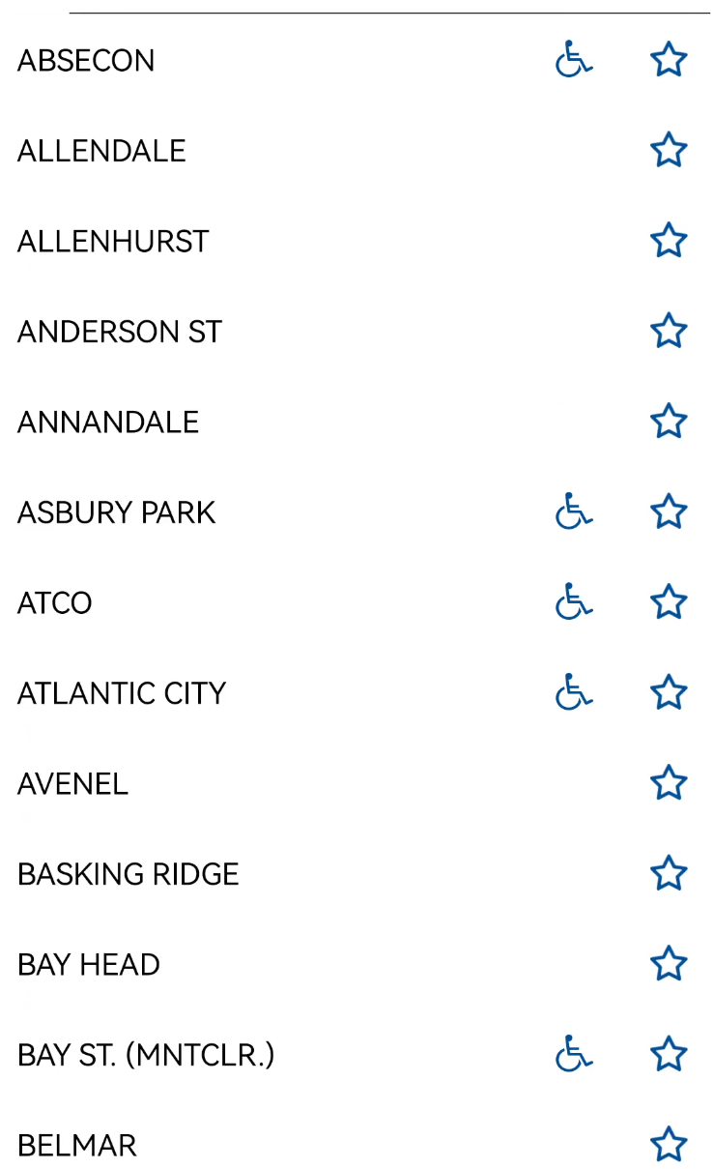
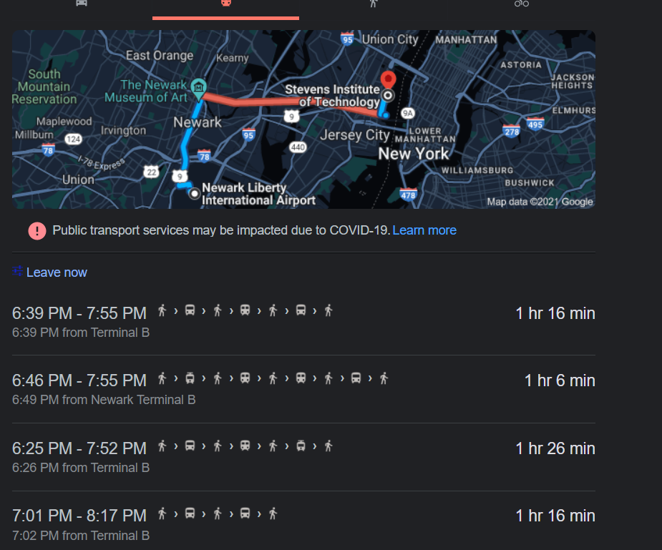
Story

Slide 3
Wonder
Where am I?
Where do I get on the bus/trip?
Where do I end?

Slide 4
Three user stories: user story 1
As a visitor,
I want all buses not to be charged by zone.
So that I don't have to look up too much information to buy a ticket.

Slide 5
Three user stories: user story 2
As a passenger,
I want to be auto charged after taking the bus.
So that I can get off early or make extra stops on the bus without waste or fare evasion.

Slide 6
Three user stories: user story 3
As a subway manager,
I want to charge by distance, not by number of transfers.
So that attract short distance passengers to take the subway instead of taxi.

Slide 7
Requirements
Buses/subway not to be charged by zone
be auto charged after taking the Buses/subway
Buses/subway charge by distance, not by number of transfers

Slide 8
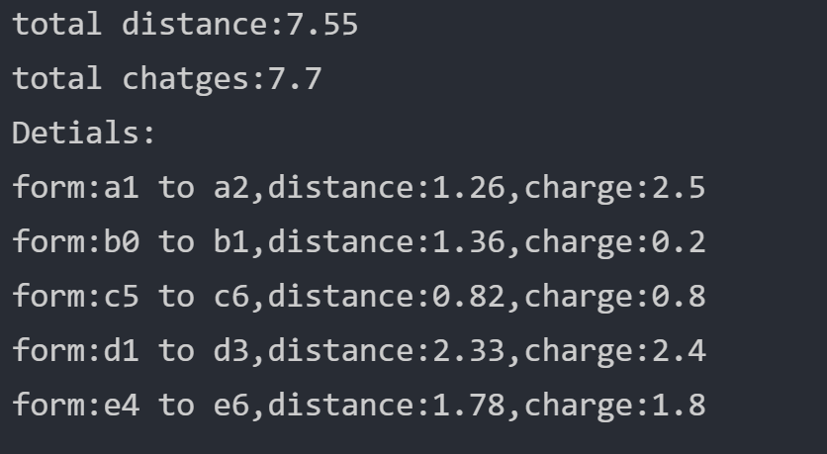
Solution: Charge by distance
Different of two charges
It was a 7.55-mile journey.
The tourists transferred to five lines
If the 5 lines are not crossed,
there is a charge of 2.75*5=$13.75
If the distance charge is used,
the result is $7.70
Save 80% Cost!
Best of all,
you only need to pay once by Auto pay, not pay five times.

Slide 9


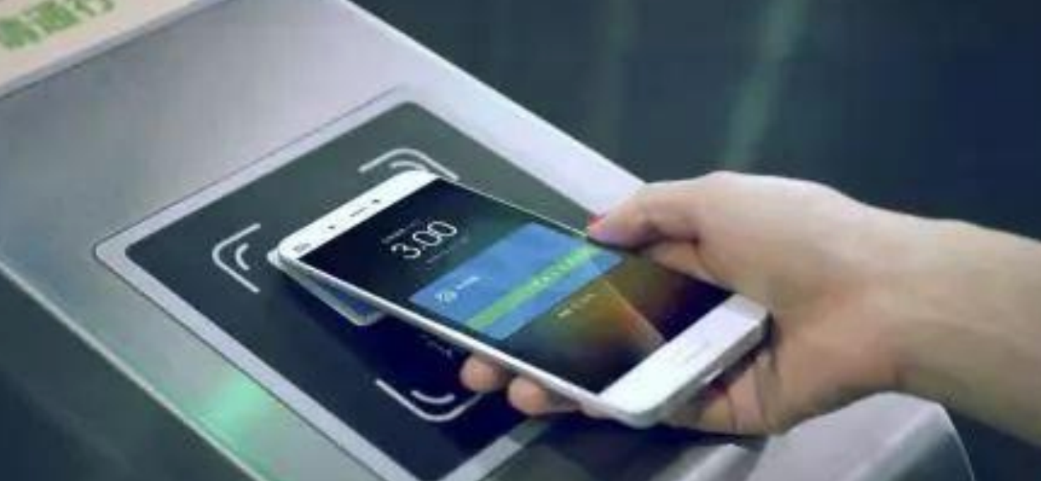
Step 1
Station 1
Station 2
Trip 1

Slide 10

Step 2
Trip K
Transfer station
Within 15 mins
Transfer station
Trip K+1

Slide 11

Step 2
Trip K
Transfer station
Out off 15 mins
Billing and Auto Pay

Slide 12
Step 3: Charge single trip by distance
Charge(L): The charge by the distance L miles
if L<=2.5 miles:
Charge(L)=$2.5
if L > 2.5 miles:
$0.2 per additional 0.2 mile after 2.5 miles

Slide 13
Step 3:Calculate all trips’ charges
Charge(L): The charge by the distance L miles
T_{i} : Total charges up to Trip i
S_{i} : A separate charge for Trip i
Trip 1
Distance L₁ ,T₁=Charge(L₁), S₁=T₁
Trip 2
Distance L₂ ,T₂=Charge(L₁+L₂),S₂=T₂-T₁
Trip 3
Distance L₃ ,T₂=Charge(L₁+L₂+L₃),S₃=T₃-T₂
……
Trip K
Distance L_{k} ,T_{k}= Charge(L₁+L₂+…+L_{k}), S_{k}=T_{k}-T_{k-1}
Total charge: Charge(L₁+L₂+…+L_{k})

Slide 14
Step 4: Special cases
1. Without begins or ends for a trip?
Charge as a single trip and the distance is the length of the line.
2. Spend a long time on a trip? If spend a trip longer than 3 hours. Same as Q1

Slide 15
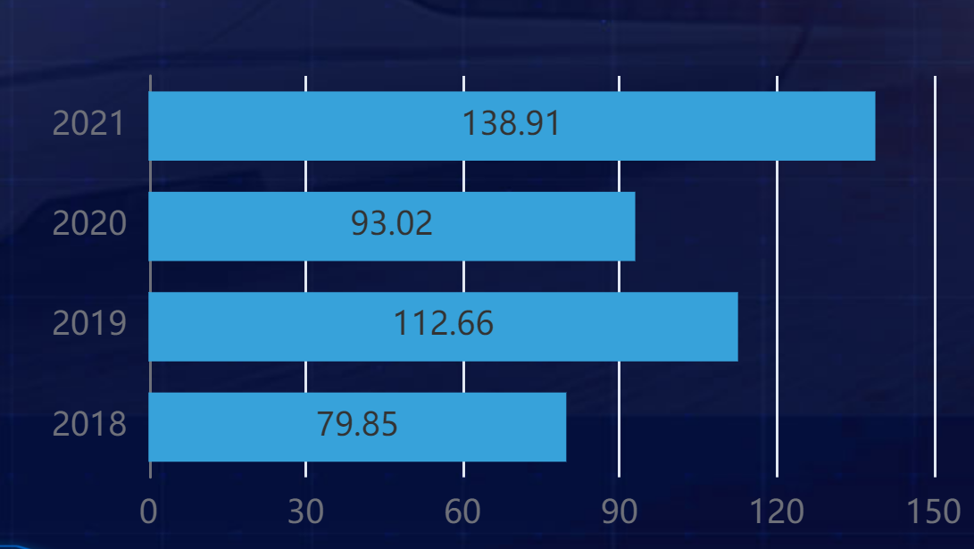
Example
Zhengzhou, a city in China.
From: 2018-2019
No other improvement.
Only a more intelligent charging method
Promotion rate：40%

Slide 16
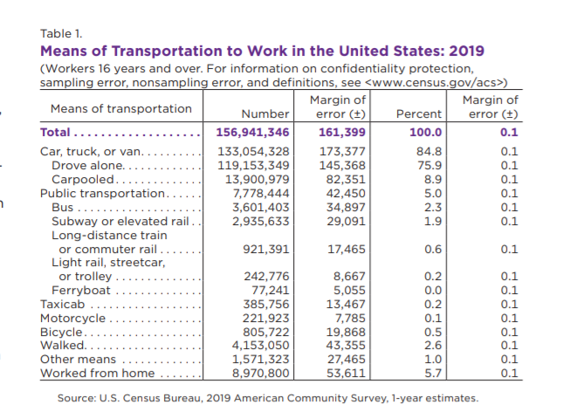
Data collection and analysis

Slide 17
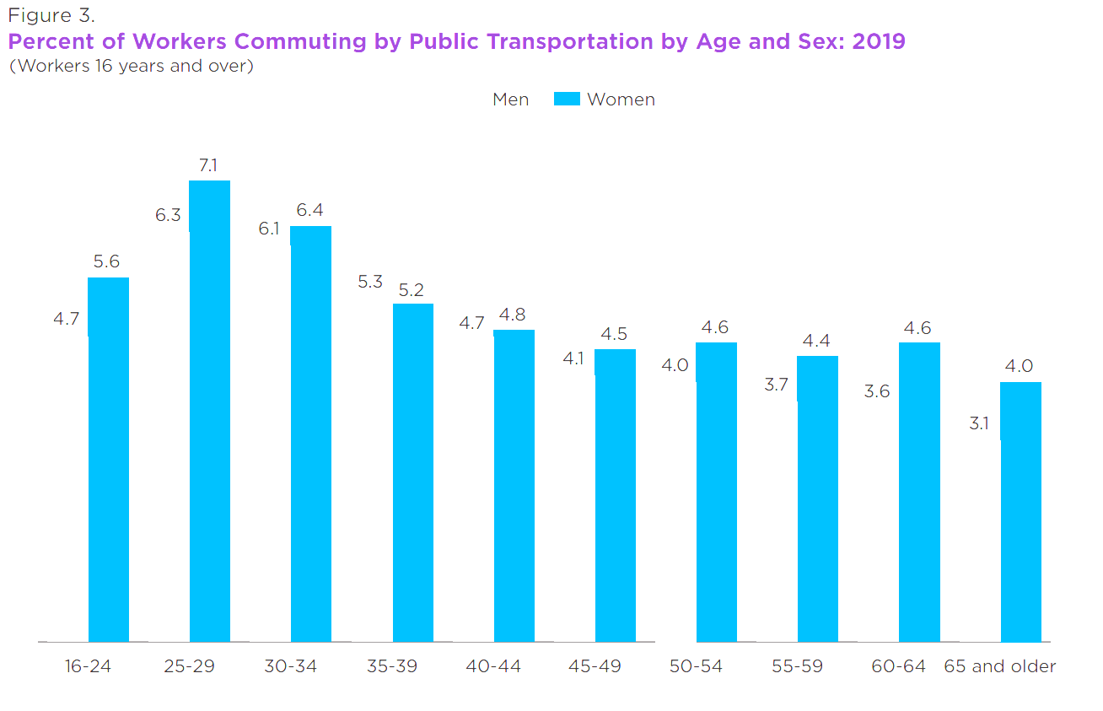
Data collection and analysis

Slide 18
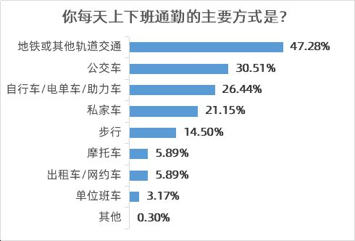
Data collection and analysis

Slide 19
Influence 1
By combining data analysis above.
New payment method
Smart devices
Attracting more people to travel by public transport.

Slide 20
Influence 2
For individuals
1.Saving time and money.
2.Travel experience.

Slide 21
Influence 3
For public transport suppliers
More residents -> more income
Infrastructure construction improve

Slide 22
Influence 4
Government and environmental protection
departments.
Traffic jam
Protection of the environment.

Slide 23
Thanks!

